Slide 1

Past, Present & Future of PCE
Dhruv Dhody
Huawei
PCE WG Secretary

Slide 2
What is PCE?
A Path Computation Element (PCE) is an entity (component, application, or network node) that is capable of computing a network path or route based on a network graph and applying computational constraints.

Slide 3
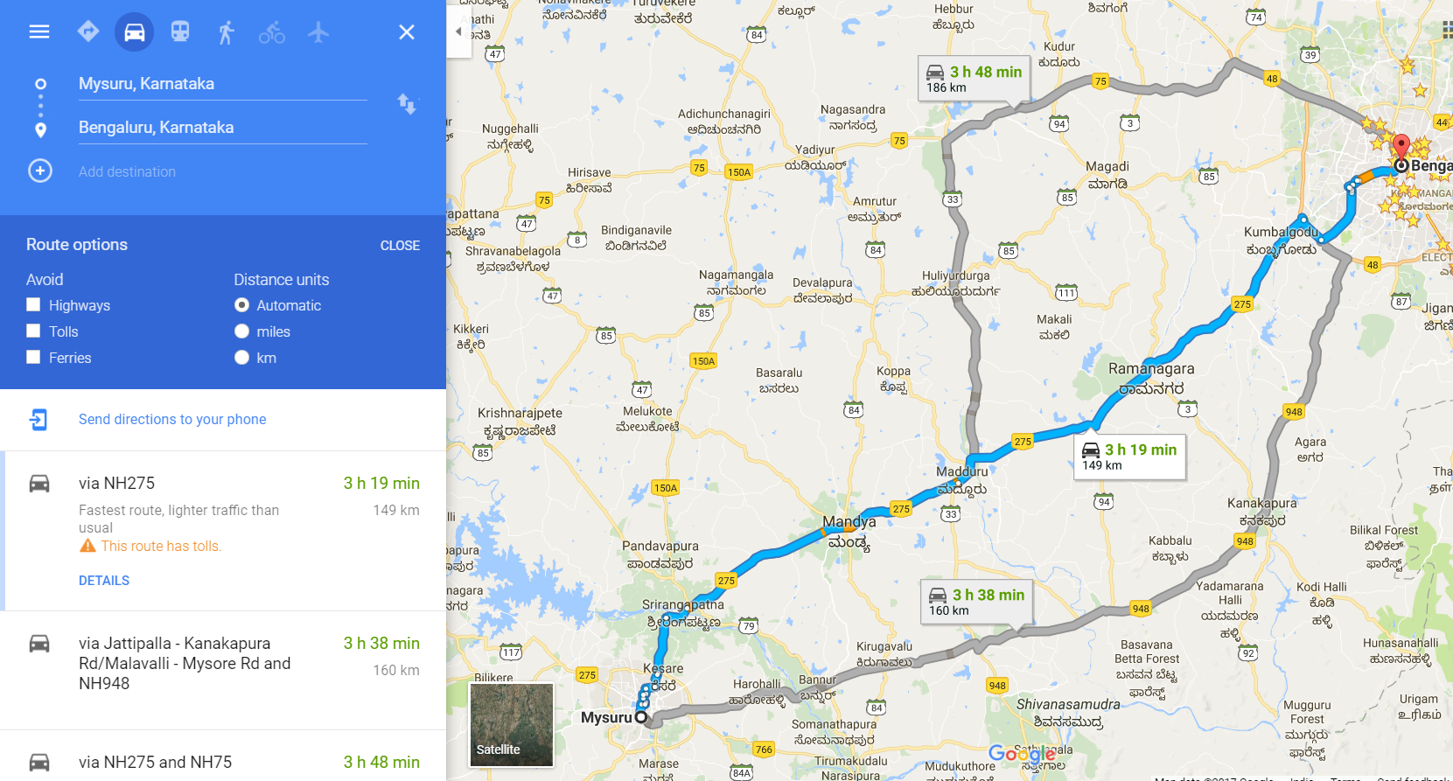
So, What is it?
Endpoints
Constraints
Path
Traffic Engineering Database

Slide 4
The Basics!
PCE
Path Computation Element
Part of SDN controller
PCC
Path Computation Client
Router offloads path computation to a specialized PCE
PCEP
PCE Protocol to communicate between PCC and PCE(s) using TCP
Specializes in complex path computation on behalf of PCC
PCE WG
Chartered in 2004
Yes, its that old!
First RFC – RFC4655 (in 2006)
Since then 38 RFC further published!

Slide 5
But Why?
The path is usually computed by the source node (Ingress)
Does not have enough computation power or space
Low end devices (with MPLS moving towards edge!)
Does not have all the information!
Inter-domain / Inter-layer path computation across domain boundaries!
Special Path Computation algorithms
PCC
PCE Protocol (PCEP)
PCE
PCE

Slide 6
The History!
Basic PCEP
BRPC – PCE Inter-domain
Confidentiality in PCEP
Objective Functions
Protection Path
P2MP
Hierarchy of PCE (H-PCE)
GMPLS network
Inter-layer

Slide 7
But, Stateless!
Even though PCE could do complex path computation by itself or by working with other PCEs
It could do that only when the PCC asks for it!
Even when PCE learns of topology change
It cant do much!
So far the PCEP was a simple client-server protocol
and stateless!
Only TEDB – Traffic Engineering Database!

Slide 8
Stateful PCE
Now, along with network state (TEDB), if the PCE also stores the state of all the computed paths or LSPs and their resources (lets call it LSP-DB)
We could do so much more and that is Stateful PCE!
Passive
It uses the TEDB and LSPDB while path computation, but computation is done only when requested by PCC.
Active
It allows the LSP to be delegated to the PCE where PCE becomes the owner of the LSP and can change any attribute of the LSP at anytime.
The Stateful PCE can do global re-optimization considering various LSPs to optimize the whole network!

Slide 9
PCE Initiated
Setup, maintenance and teardown LSPs directly by the PCE!
No need for local configuration at the device!
Allowing for a dynamic network that is centrally controlled and deployed.
Useful when the LSP placement needs to change in response to application demands.
Agile software-driven network operation, and can be seamlessly integrated into a SDN controller-based network architecture!!
PCE Initiate Message

Slide 10

SR & PCE
Stateful PCE with SR
Segment Routing Path
PCE prepare label stack identifying node and adjacency labels
PCE
PCE computes the SR Path and instructs the head-node with a label stack.
PCE can respond to network events like congested links and update the label stack
PCE is the magic, that makes SR work!
PCEP
Protocol
1417
1568
1923
payload

Slide 11
Other Enhancements to Stateful PCE
Association
P2MP / Multicast
Inter-domain
Hierarchy
Auto-bandwidth
GMPLS
Scheduling

Slide 12
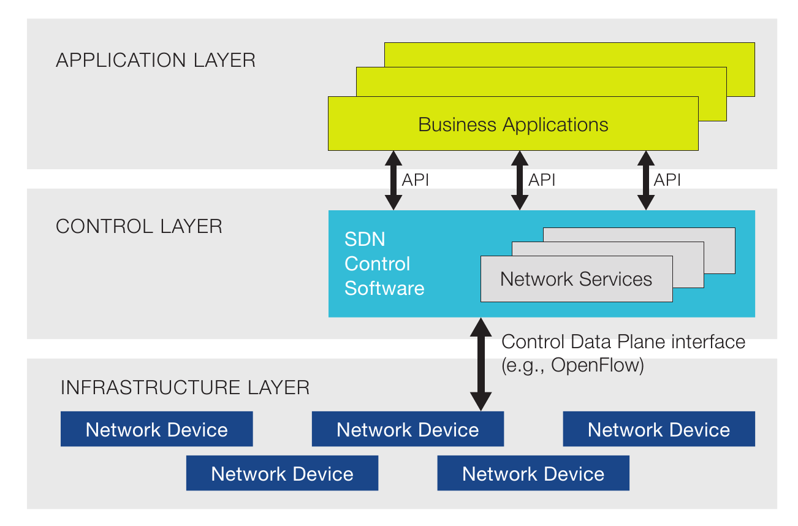
PCE & SDN
Abstraction & Algorithms over Stateful PCE
Stateful PCE Server
PCEP
Protocol
In some network with existing investment in IP/MPLS devices, active stateful PCE can offer centralized control over the LSPs as a simple evolutionary approach for SDN.
PCC
PCC

Slide 13
PCEP as a SBI
PCE is a core of a SDN controller
Should PCEP be upgraded to a full-fledged SBI?
What is needed to do that?
Ability to use PCEP to program each node along the path of the LSP
Ability to use PCEP for label dissemination for SR
Ability to identify which traffic flows in the LSP
Ability to use PCEP to learn topology changes
Multicast / P2MP
Coordinate between PCEs
and so on….

Slide 14

PCE as Central Controller
PCECC – PCE as a central controller
Stateful PCE with Initiation
PCEP
Protocol
PCEP
Protocol
RSVP Signaling
All nodes are PCC
PCC
PCC
Free from signaling protocols
PCECC communicates to all nodes
Central controller!
PCECC responsible for label allocation

Slide 15
Others
PCEP-LS
Flowspec
BFD
Optical
P2MP

Slide 16
Role of PCE in ACTN
Controller
PCE is a key function in a controller
Application Based Network Operations [RFC7491]
Multi-Domain & Multi-Layer
Per-domain path computation [RFC5152]
PCE based central control (PCECC)
Backward Recursive Path Computation (BRPC) [RFC5441]
Hierarchy of PCE (H-PCE) [RFC6805]
Inter-Layer [RFC5623]
Stateful PCE
Initiation capability
Stateful H-PCE
ACTN – Abstraction and Control of TE networks
Multi-layered multi-domain Network
Technology, administrative or vendor islands
Interoperability
Facilitate virtual network operations
Creation of a virtualized environment allowing operators to view and control multi-subnet multi-technology networks into a single virtualized network.
Accelerate rapid service deployment of new services
including more dynamic and elastic services
improve overall network operations and scaling of existing services.

Slide 17

Making PCEP Secure
Supported MD5 and TCP-AO
MD5 no longer used!
Support for TLS – RFC 8253 published recently!
Peer authentication, message encryption & integrity
StartTLS approach

Slide 18
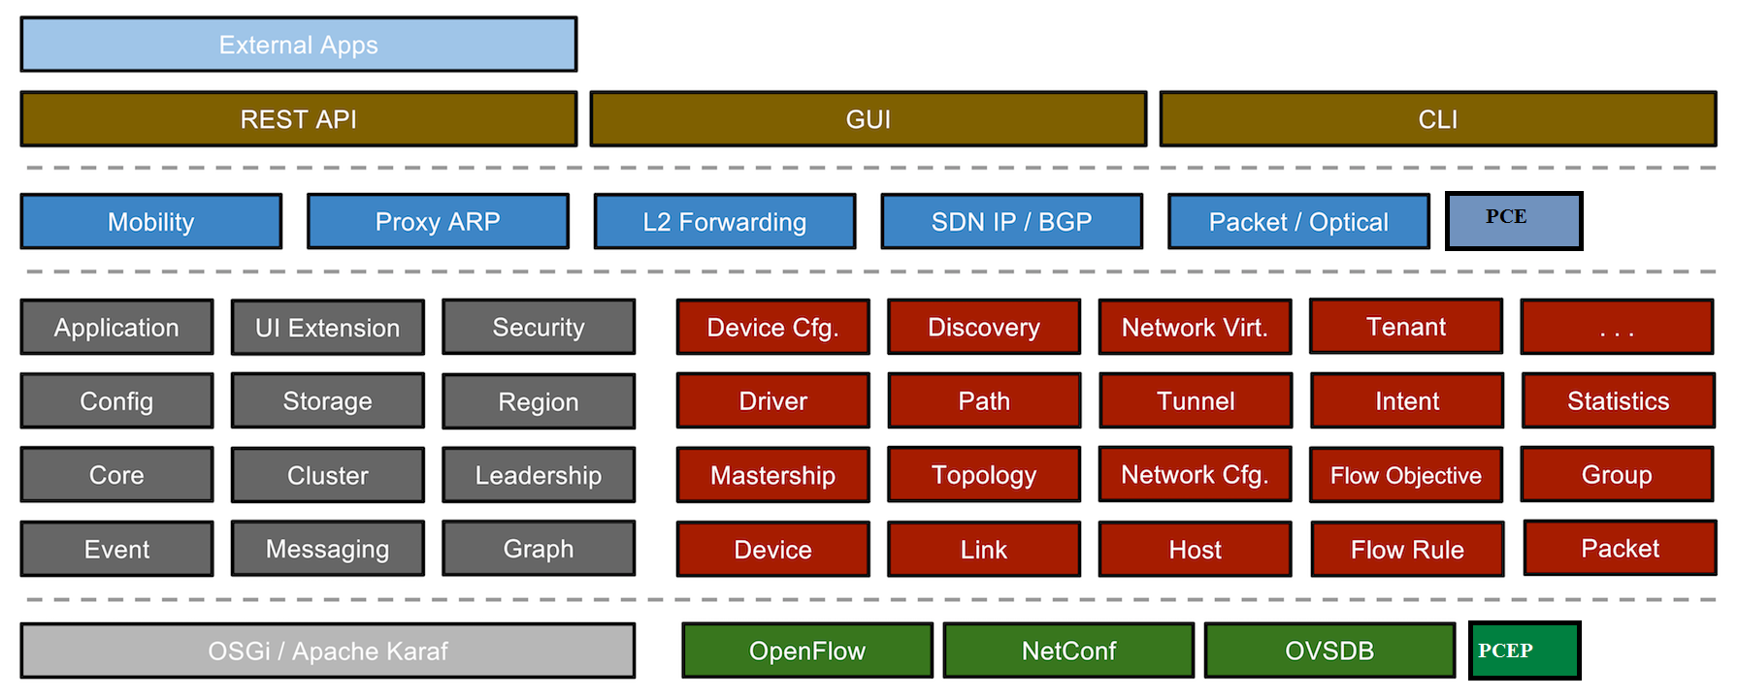
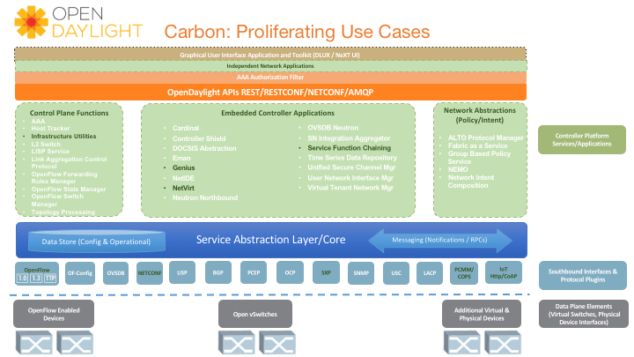

PCE in Open Source
PCEP

Slide 19
Join us at PCE WG
pce@ietf.org

